Slide 1



QueryMate Text to SQL & CSV

Slide 2
TABLE OF CONTENT
01
PROBLEM STATEMENT
02
FLOWCHART
03
TECHNOLOGY USED
04
FEATURES
05
DEPLOYED WEB APP

Slide 3
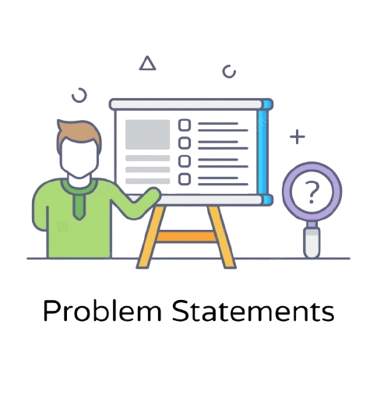
PROBLEM STATEMENT
Non-technical users often struggle with accessing and analyzing structured data due to complex syntax and database management, limiting their ability to make informed decisions.
QueryMate solves this by converting natural language inputs into SQL or pandas queries, enabling users to easily access and analyze data without coding knowledge, and empowering them to derive insights and drive business outcomes.

Slide 4
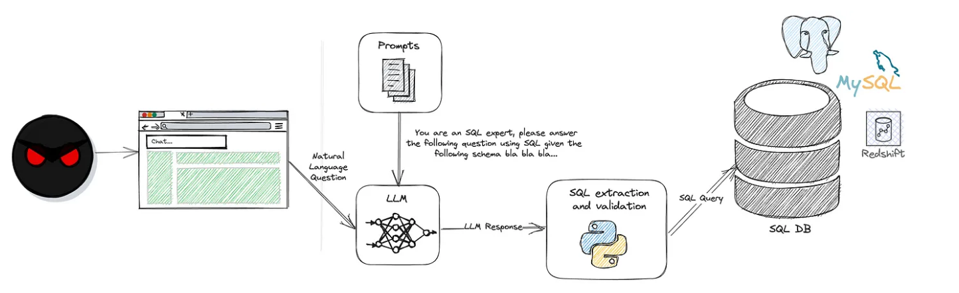





FLOWCHART

Slide 5






TECHNOLOGY USED

Slide 6
FEATURES
Natural Language Querying: Allows users to input questions in plain language, which are then automatically converted into executable SQL or pandas commands.
Multi-Source Compatibility: Supports both SQLite databases and CSV files, providing flexibility to work with various data sources.
User-Friendly Interface: Offers a simple, interactive environment where users can type queries, view results, and track their query history.
Session Persistence: Retains chat history across sessions, enabling users to refer back to previous queries and results.
Reliability: Ensures consistent and accurate output by generating the corresponding SQL or pandas commands for every query.

Slide 7
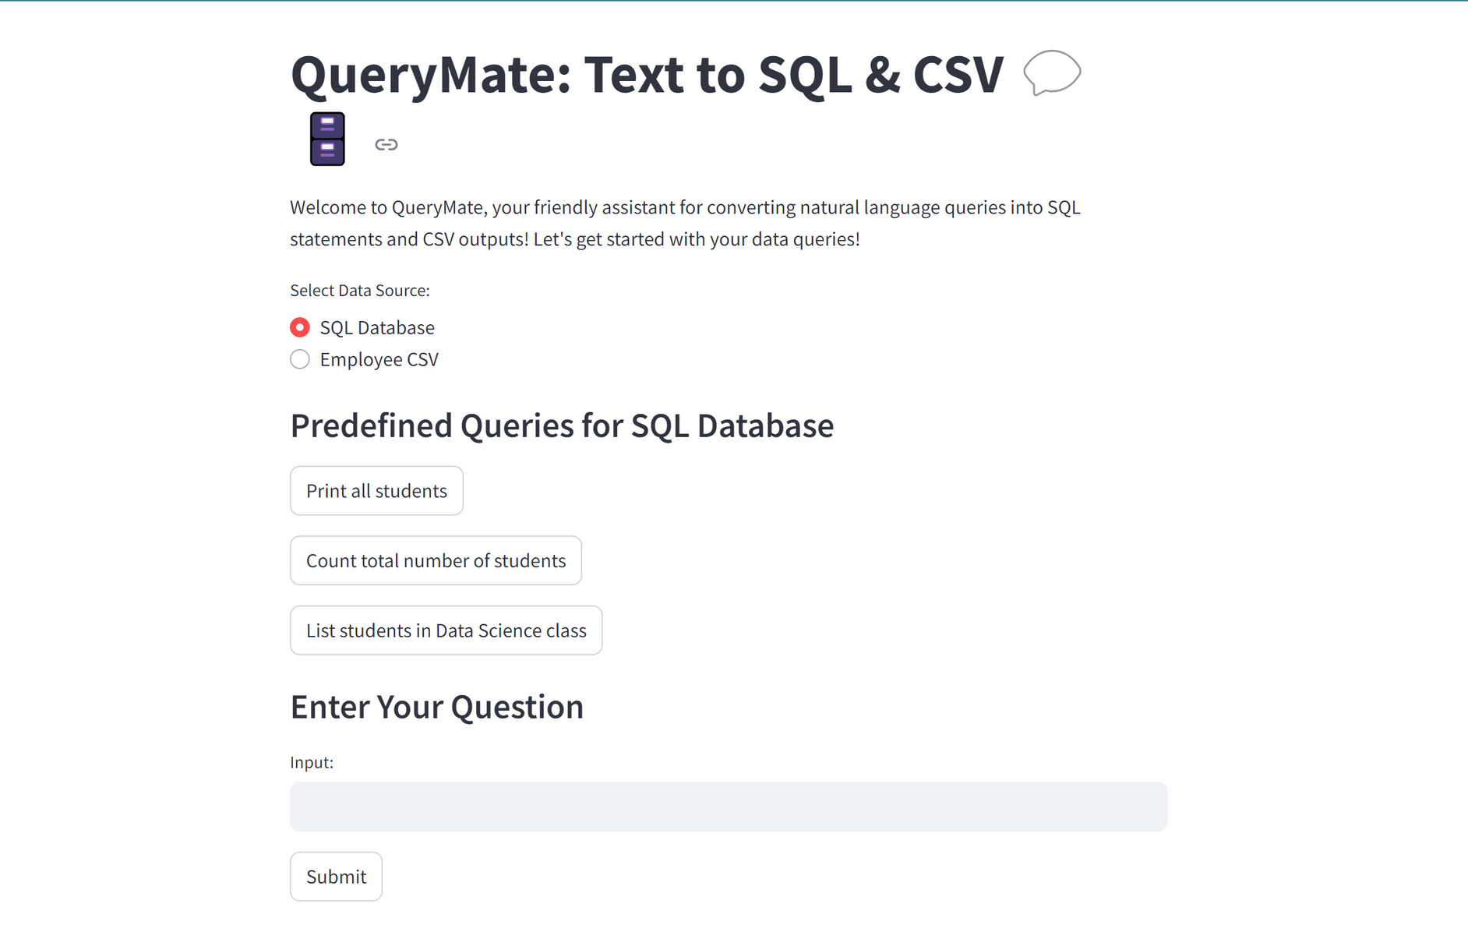
Hugging Face Spaces: https://huggingface.co/spaces/pratham0011/QueryMate_Text-to-SQL-CSV
Docker Hub Repository: https://hub.docker.com/r/prathamkumars125/querymate-text-to-sql-csv

Slide 8
THANK YOU
Name: Pratham Kumar
Course: AI-DS
Enroll No: 00119011921

